Slide 1
Budgeting Basics
Getting Started with Build-a-Budget

Slide 2
Agenda / Procedure
Hook (5mins): Class poll (list two needs and two wants)
Demo (10mins): Show one pay period in build-a-budget
Guided Play (20mins): Students try pay period 1 in pairs
Debrief (5mins): Share major budget trade offs
Worksheet (5mins): Complete worksheet needs vs wants chart

Slide 3
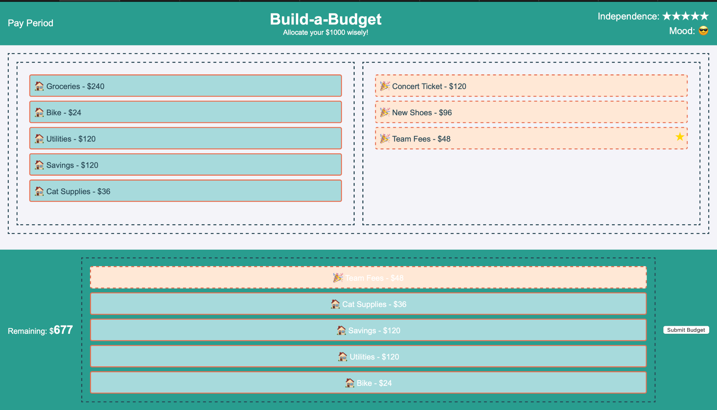
Game Demo

Slide 4
Guided Play
Step 1: Choose your housing, transport, interests tiles
Step 2: Allocate savings
Step 3: Select or skip non-essentials if over budget
Step 4: Record your remaining balance

Slide 5
Reflection Questions
Which categories “cost” you the most?
What trade-offs did you make?
How would you adjust in pay period 2?

